Slide 1
How to Deploy PaddlePaddle on Arm Cortex-M with Arm Virtual Hardware
- By Rishabh Kumar Srivastva

Slide 2
OBJECTIVE
To Apply Deep Learning (DL) to the OCR text detection and carry out the following steps:
Use PaddleOCR to obtain a trained English text recognition model
Export the Paddle inference model
Compile the Paddle inference model with TVMC for target device
Build text recognition application and deploy it on the Arm Virtual Hardware Corstone-300 platform which uses Arm Cortex-M55 processor.

Slide 3
What is Paddle OCR ?
Optical Character Recognition (OCR) aims at recognizing the text content of a fixed image area. Text recognition is a sub-task of OCR. It is the next step after text detection in OCR’s two-stage algorithm, which can convert image information into text information.
PaddleOCR is a multilingual and practical OCR tools that help users train better models and apply them into practice.
PaddleOCR provides an OCR system named PP-OCR. This is a self-developed practical ultra-lightweight OCR system created by the Baidu Paddle Team. It is a two-stage OCR system, in which the text detection algorithm is called DB, and the text recognition algorithm is called CRNN.

Slide 4
What is Paddle Inference Model
Machine learning inference—involves putting the model to work on live data to produce an actionable output. During this phase, the inference system accepts inputs from end-users, processes the data, feeds it into the ML model, and serves outputs back to users.
Paddle Inference is Paddle's native inference library, which works on the server and cloud to provide high-performance inference capabilities. Since the capability is directly based on the Paddle training operator, Paddle Inference can universally support all models trained by Paddle.
It can achieve high throughput and low latency, ensuring that the paddle model can be trained and used on the server side and quickly deployed.

Slide 5
What is Arm Virtual Hardware
As part of core technology of Arm Total Solutions for IoT, Arm Virtual Hardware (AVH) provides cloud-deployable virtual models of Arm devices.
AVH solves many of the pain points that testing and development on physical hardware face. These include difficult expansion of testing, high-cost operation and maintenance of board test farms and so on. AVH provides a simple, convenient, and scalable way to free the development of IoT applications from the dependency on physical hardware.
Arm directly provides a way to access Arm Virtual Hardware for developers to use. It is ‘AVH Corstone’ and ‘AVH Cortex CPUs’ .

Slide 6
CORSTONE – 300 : It is a platform which uses the Cortex-M55 processor.
CORTEX – M55 : It is Arm’s most AI-capable Cortex-M processor and the first to feature Arm Helium vector processing technology for enhanced, energy-efficient digital signal processing (DSP) and machine learning (ML) performance. The Cortex-M55 offers an easy way to implement AI for IoT with the ease-of-use of Cortex-M, a single toolchain, optimized software libraries, and an industry-leading embedded ecosystem.

Slide 7
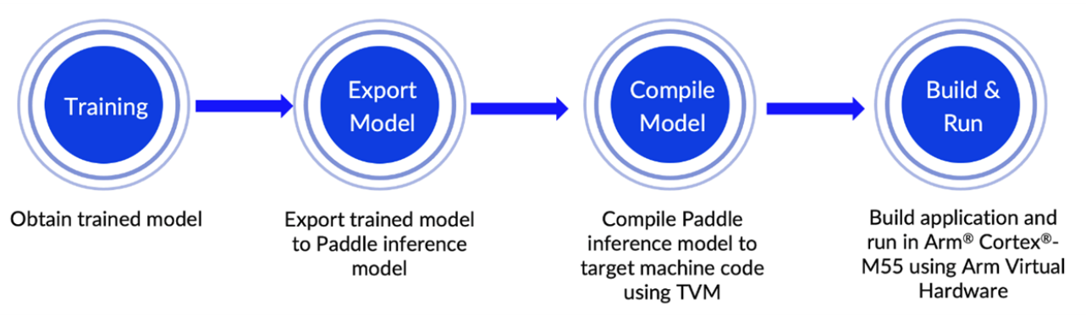
End to End Workflow

Slide 8
Step 1: Train an English text recognition model with PaddleOCR
PaddleOCR provides many practical OCR tools that help you train models and apply them into practice.
PaddleOCR uses configuration files(.yml) to control network training and evaluation parameters. In the configuration file, you can set the parameters for building the model, use your own datasets or Open source datasets like MJSynth and SynthText (MJ+ST), optimizer, loss function, and model pre- and post-processing.
PaddleOCR reads these parameters from the configuration file, and then forms a complete training process to complete the model training. Fine-tuning can also be completed by modifying the parameters in the configuration file, which is simple and convenient.

Slide 9
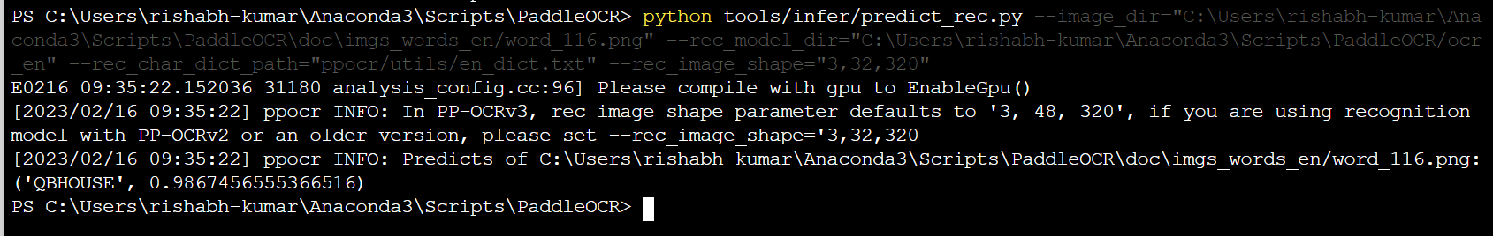
Step 2: Export Paddle inference model
We must export the trained text recognition model to a Paddle inference model that we can later (next step) compile to generate code which is suitable to run on a Cortex-M processor.
Since we don’t have a trained model, we have directly downloaded the already trained and exported Inference model “ocn_en.tar”.This file is extracted to a folder before going ahead
Test the code with an Inference Model “ocr_en” and a image “word_116.png” as input.
We can see the text was correctly identified as “QBHOUSE” with an accuracy of 98.67%

Slide 10
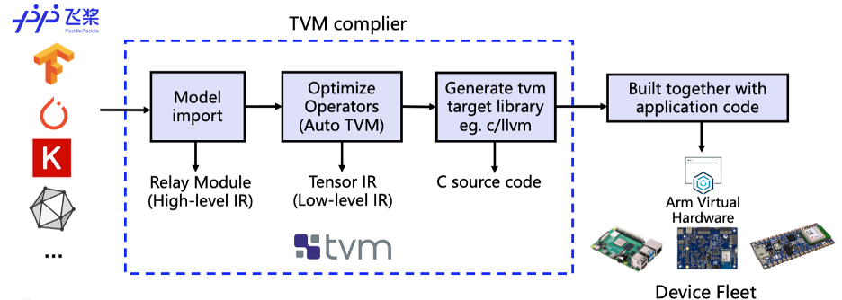
Step 3: Compile Paddle inference model with TVMC
We use the deep learning complier TVM for model conversion and adaptation. It converts these models into code that can run inference tasks on the target device.
TVM is an open-source deep learning compiler. It is mainly used to solve the adaptability problem of deploying various Deep Learning frameworks on a wide range of hardware targets.(see figure below).
Fig: Schematic diagram of compilation process

Slide 11
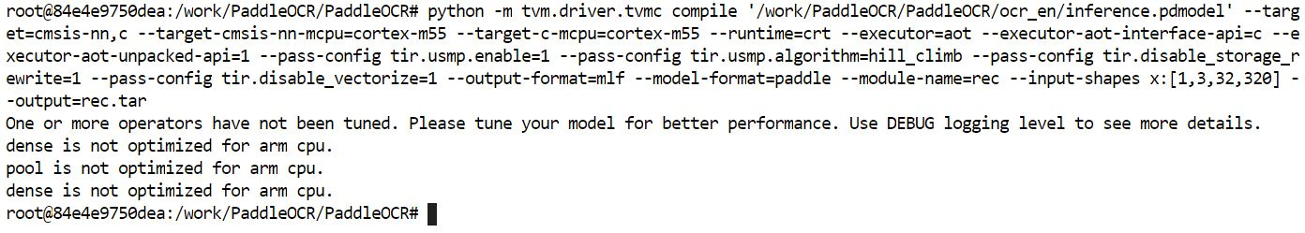
We use TVM’s Python application TVMC to compile the model.
By specifying --target-cmsis-nn-mcpu=cortex-m55 and --target-c-mcpu=cortex-m55, it compiles the code that is suitable for running on Cortex-M55 processor.
A file “rec.tar” was created after compiling the inference model and was stored in the same directory as the Model.

Slide 12
Step 4: Deploy on the AVH Corstone-300 platform with Arm Cortex-M55
We have to use the ssh command to connect to the AVH AMI instance that we launched beforehand.
After you connect to the AVH AMI instance successfully, you can complete model deployment and view application execution results by running a simple shell script.
On AVH, we directly run the Shell script “run_demo.sh” which does the training, exporting to Inference model and then compiling using TVM all on its own. To deploy the shell script on AVH, use the following code:
$ git clone https://github.com/PaddlePaddle/PaddleOCR.git
$ cd PaddleOCR
$ git pull origin digraph
$ cd deploy/avh
$ ./run_demo.sh

Slide 13
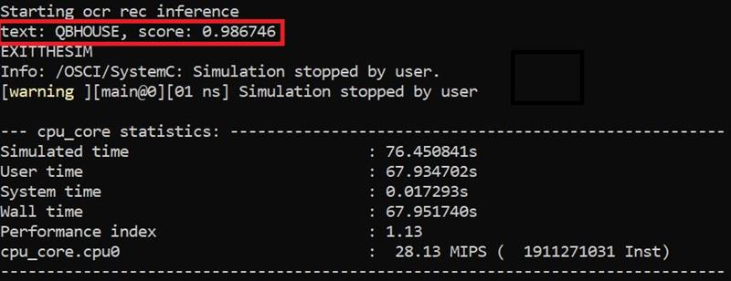
The output obtained after running the shell script on AVH is shown below:
We get a Accuracy score of 98.67% which is same as what we got using our local system.

Slide 14
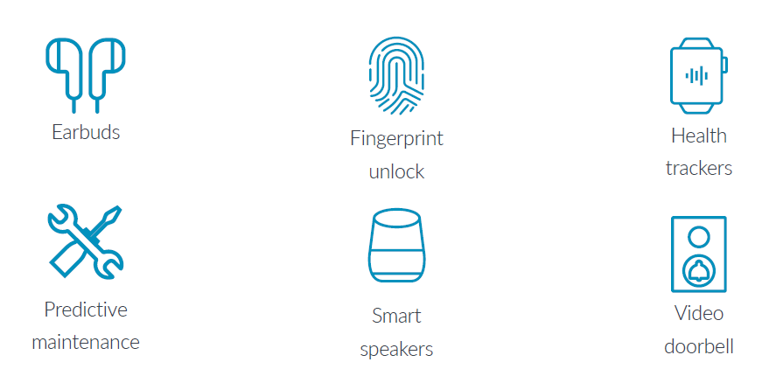
USE CASES

Slide 15
Neural Networks Update
Why DL/Neural Networks over ML
Neural Network Intro
Understanding Weights and Bias and their impact
Vector, array, Tensor and other Maths concepts/coding concepts needed
Various Activation Function like Sigmoid, tanh, Step, RELU, LeakyRELU
How to decide on an Activation Function
Loss and Cost Function

Slide 16
FUTURE SCOPE
Neural Networks:
Gradient Descent for N.N
Pytorch, Tensor1flow and Keras
Implementing Loss
Optimizations
Task by Omkar
Some hands on CNN algorithms
Learn PaddlePaddle Framework in place of Pytorch/Keras
POC (ongoing)

